Slide 1

Project Proposal for Hospital Management System
Made by Group D

Slide 2
Table of contents
01
04
02
05
03
06
Stating a Problem
Queries
About the project
ERD Diagram
Working Environment
Our team

Slide 3

01
Problem

Slide 4

The company
Gold River Clinic is a private hospital with hundreds of patients visiting regularly. The management of all the patients, their medical prescriptions and staff of doctors, admins, cashiers became a big problem. The company needs an effective management system to control customers flow.

Slide 5
02
About the project

Slide 6
About our project
We have created a database management system to control hospital administration.
Main functions:
Store information about patients and assistance provided
Store data about hospital staff and doctors
Assign each patient its doctor, medication, service and bills
Collect appointments list with information about doctor, patient, time, room, service and price
Provide data about existing treatment services

Slide 7
03
Working environment

Slide 8




What we use to work
PostgreSQL
Discord
SQL technologie
Communicating and sharing
Colab
GitHub
To work together on the same database using Python
Share code and keep track of the versions of the project

Slide 9
04
Queries

Slide 10
Examples of Queries
How many patient are currently in the Hospital?
How many doctors are specialized in a given disease?
Get all the bills for a given patient.
Get all the free surgery rooms.
Get the schedule of a doctor.
Retrieve a specific appointment.
Update the health state of a patient.
Add a new patient.
Delete a doctor that stop working in the hospital.
Get all the doctors doing more than 5 surgeries by day.
Get all the patients that will leave this week.
Retrieve all the patient with a different nationality that the hospital’s country.

Slide 11
05
ERD diagram

Slide 12
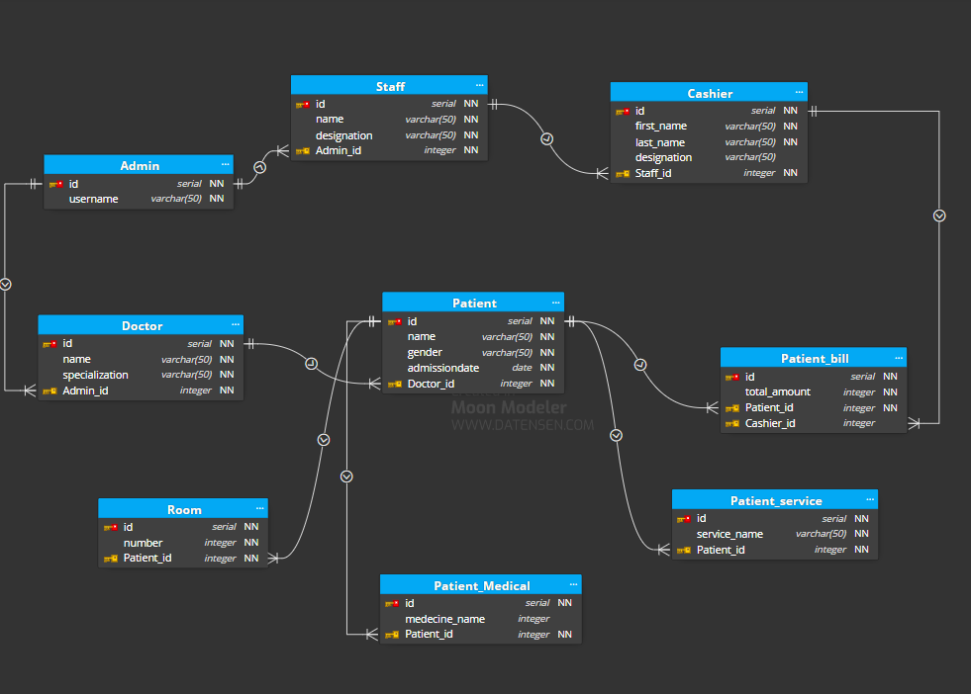

Slide 13
06
Our team

Slide 14
Our team
Rodriguez Diego
Robert Mathieu
Rogue Balthazar
12224836
12224837
12224841
Baus Philippe
Zhylkybay Nazerke
12224893
12224970

Slide 15
Thanks!
Do you have any questions?
https://github.com/Fileboss/INHA_DATABASE_GROUP_D

